Slide 1
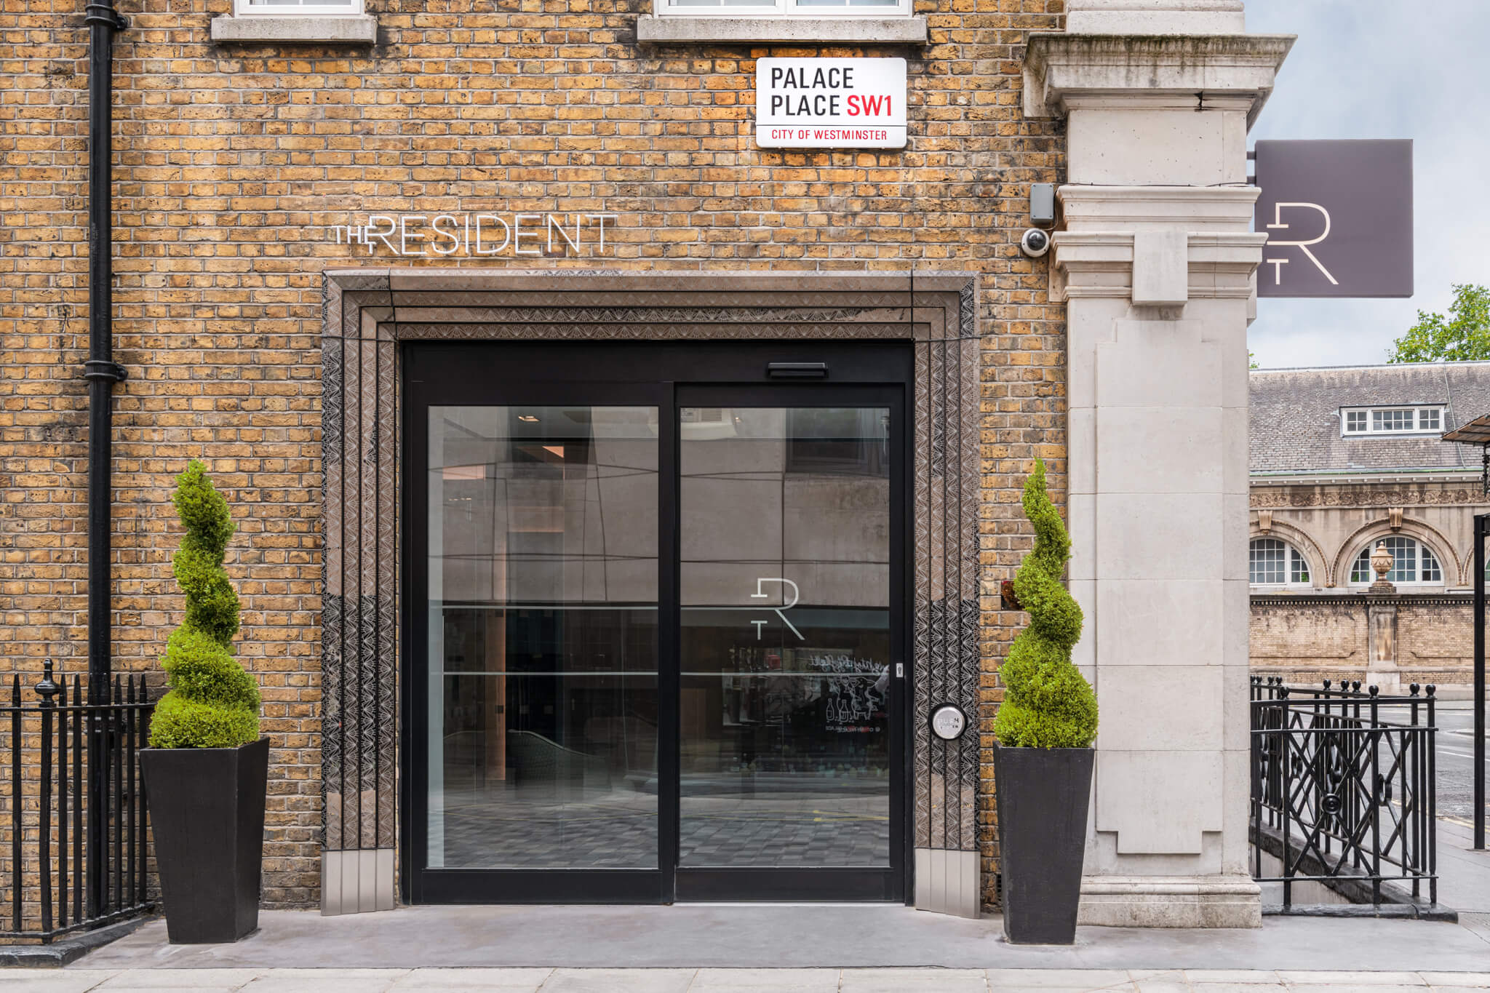

ACCESSIBLITY GUIDE

Slide 2
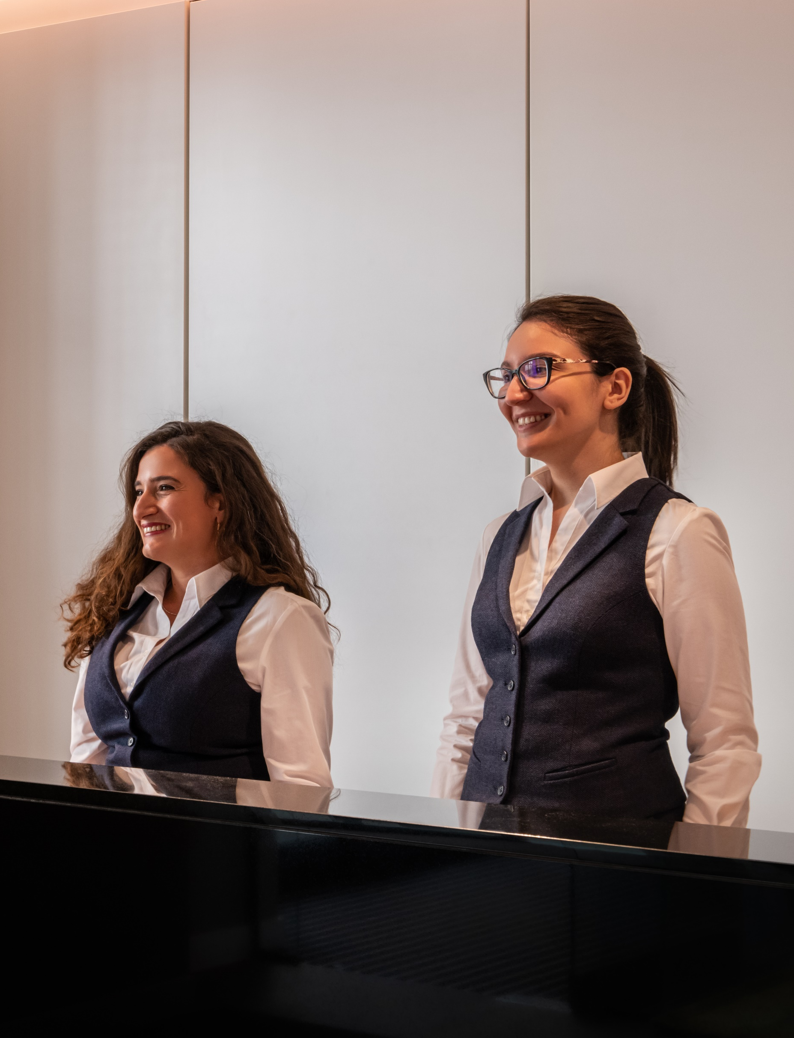
Hotel Accessibility Guide
Thank you for considering The Resident Victoria for your upcoming stay to London, we hope the below information is helpful and informative to you in your booking process.
If you would like any further assistance or information, please contact us at reservations@residenthotels.com and member of our team would be more than happy to assist you.

Slide 3
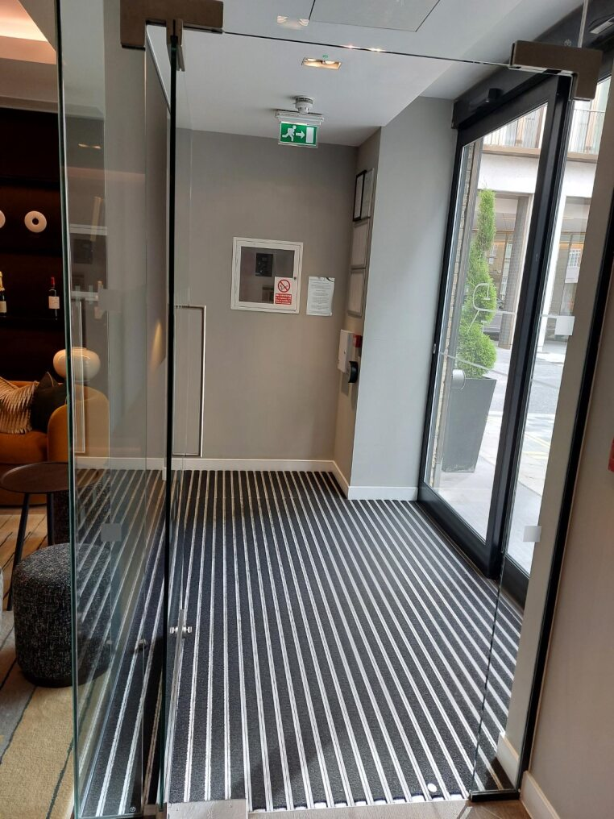
Arriving to the Hotel
When you arrive to The Resident Victoria, we recommend the main entrance on Palace Place with a quiet drop off point for cars and taxis available close to our entrance. The entrance is entirely flat with a wide set of automatic doors, able to comfortably welcome wheelchairs, mobility scooters and more.
Should you require assistance entering the building, carrying luggage or guidance to our site, a member of the team will be on hand to assist. Our Reception desk is in our front hall, with a large window offering visibility to the street outside. Once inside our reception our lounge area is flat and accessible to guests with a selection of seating.

Slide 4
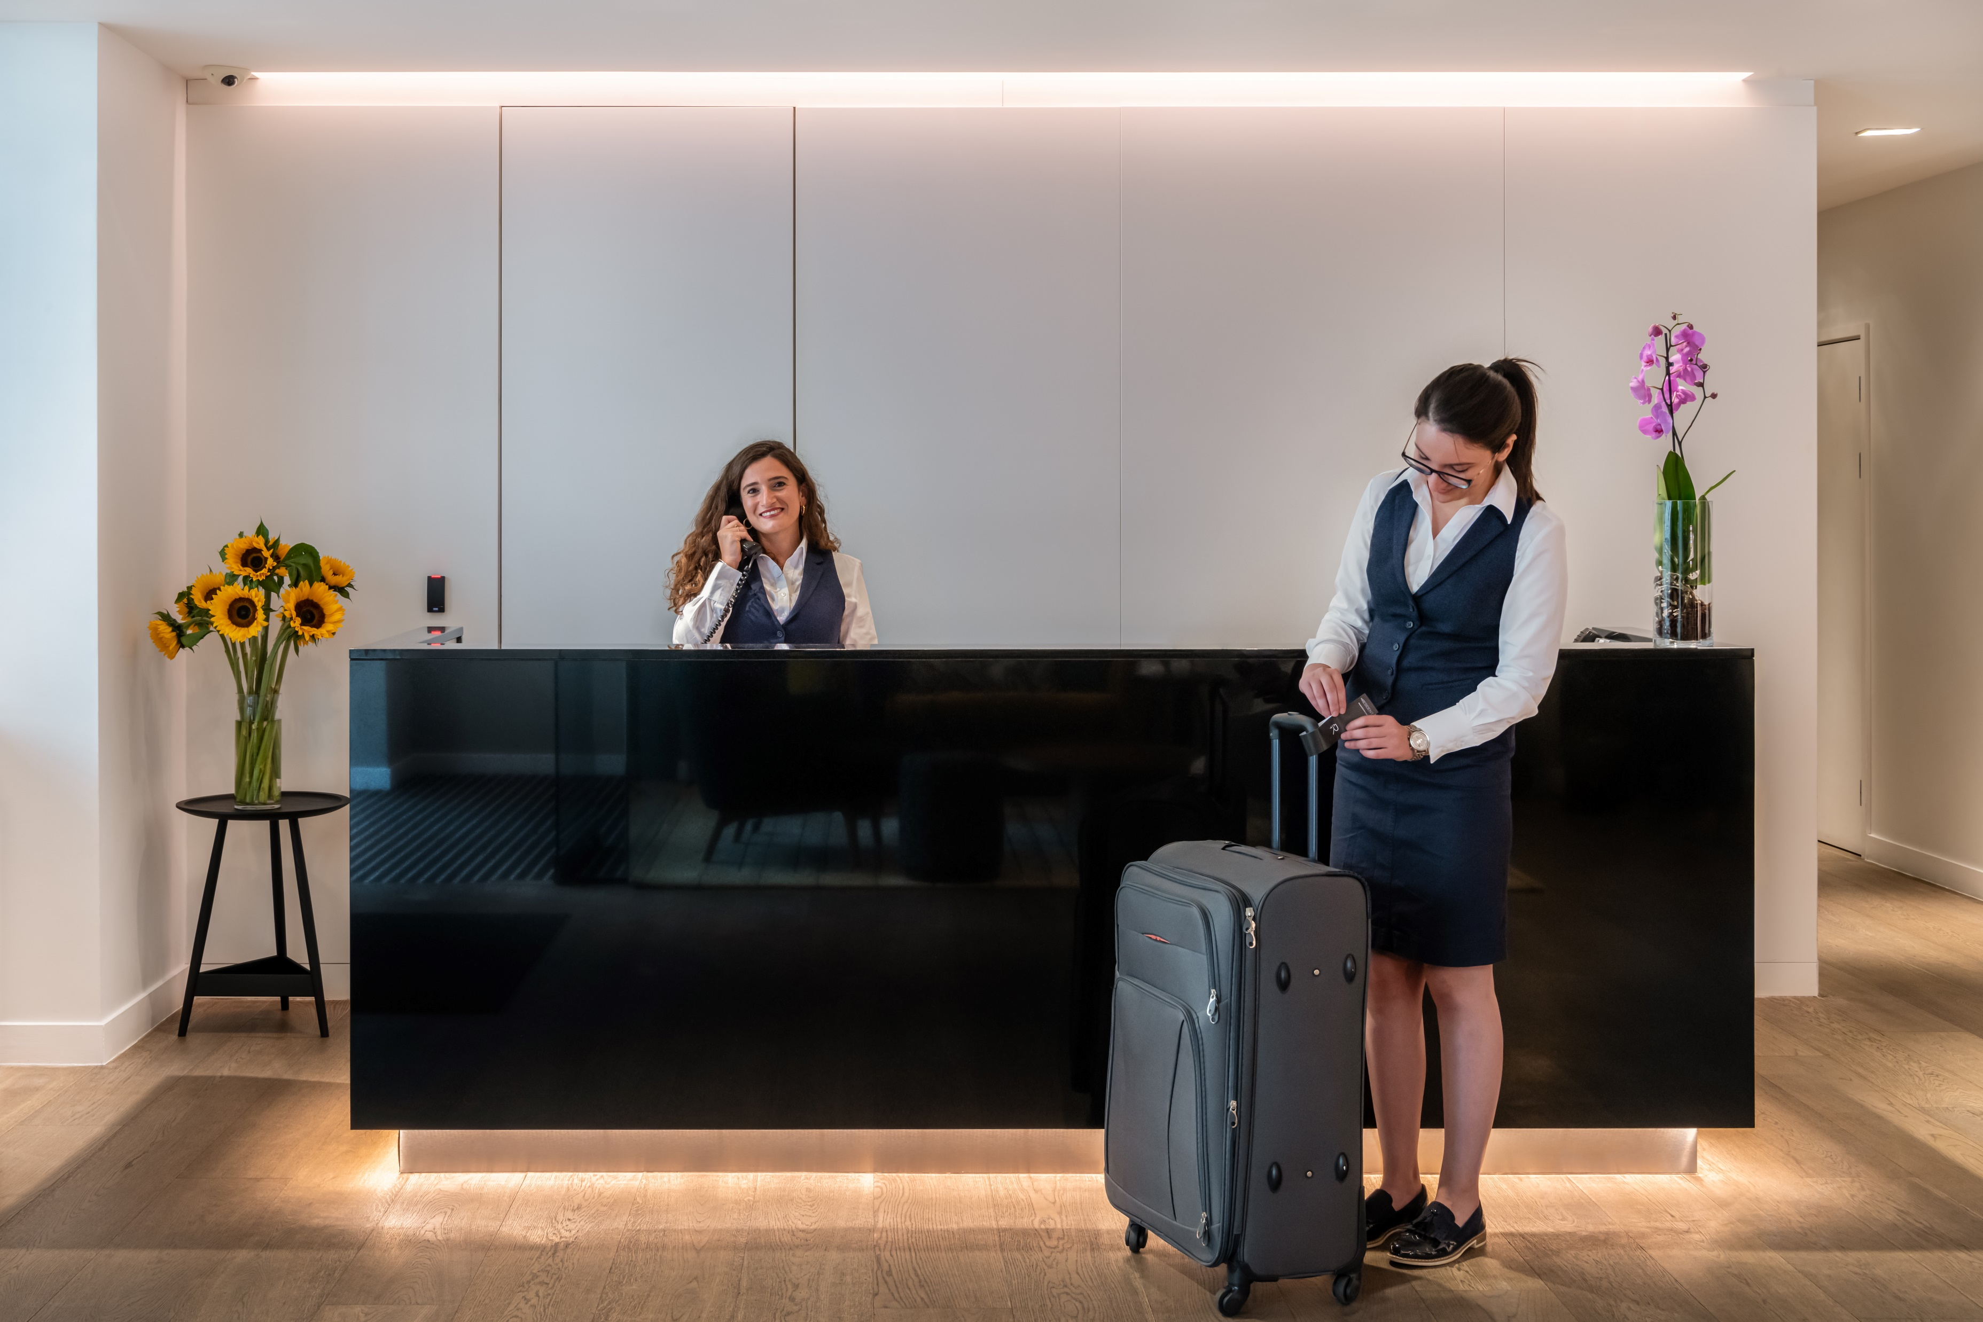
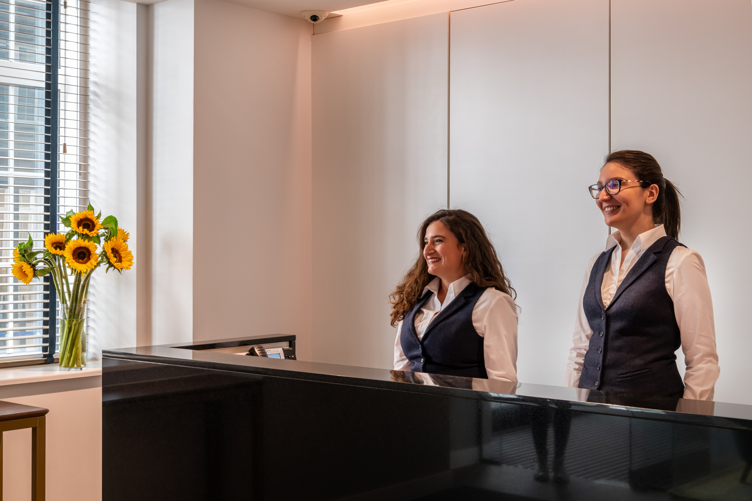
Reception
Once you have reached our entry hall, our reception desk will be just inside on your left. There is some seating available in this space for those in need of it. Our flat entry room also boasts a comfortable lounge with a collection of seating. Furniture is arranged to provide ample space for accessible aids including wheelchairs and our team would be pleased to assist further and move furnishings if needed.
Our reception features accessible wood floors, which should cause no challenges to wheelchair users.
Our reception desk also features an induction loop for guests who are hard of hearing.
Should you require any of your information in large print or any additional requests, please speak to a member of the team, who would be happy to assist.

Slide 5
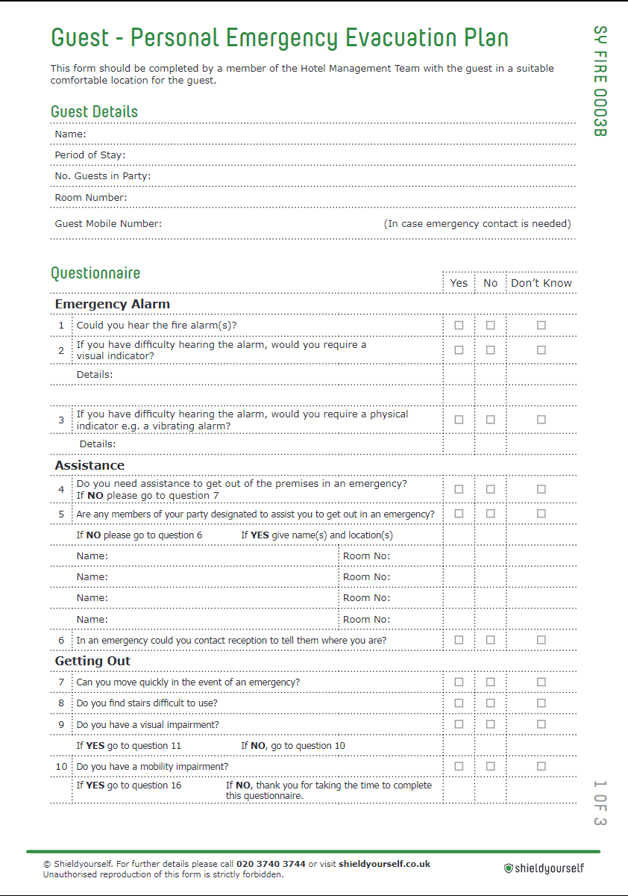
Health & Safety and Peep Forms
Upon arrival, you will likely be asked to fill in a ‘PEEP’ or ‘Personal Emergency Evacuation Plan’, in the case of fire, flood or any other emergencies.
This allows our team to gauge what support you need in the event of an emergency, whether you require assistance and how we may best protect you.
A member of our team will then guide you through how best to react in an emergency, highlight potential exit strategies and pass this on to the duty manager throughout your stay.
This best allows us to keep you safe during your visit, in the event of an emergency.

Slide 6
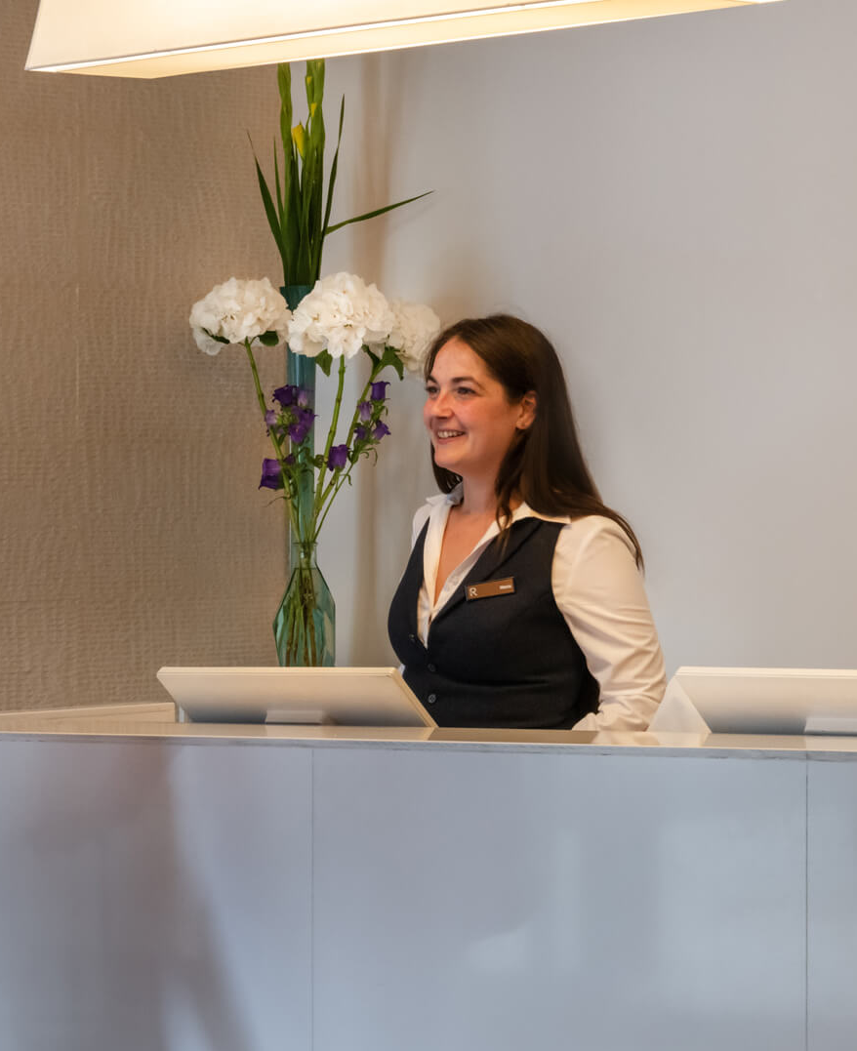
Additional Support
If you require a wake-up call, please ask a member of our team. Deaf guards are available where needed to aid hearing impaired guests.
Our hand are also on-hand to assist you in finding local recommendations and support, should you require a local chemist, restaurants to suit dietary concerns etc.
To reach our team from your room, simply call 0 on our phone system and a member of team will be in touch shortly. Alternatively, accessible rooms are each fitted with a series of red pull cords, which will alert our team to any falls, incidents or emergencies of the guest.

Slide 7
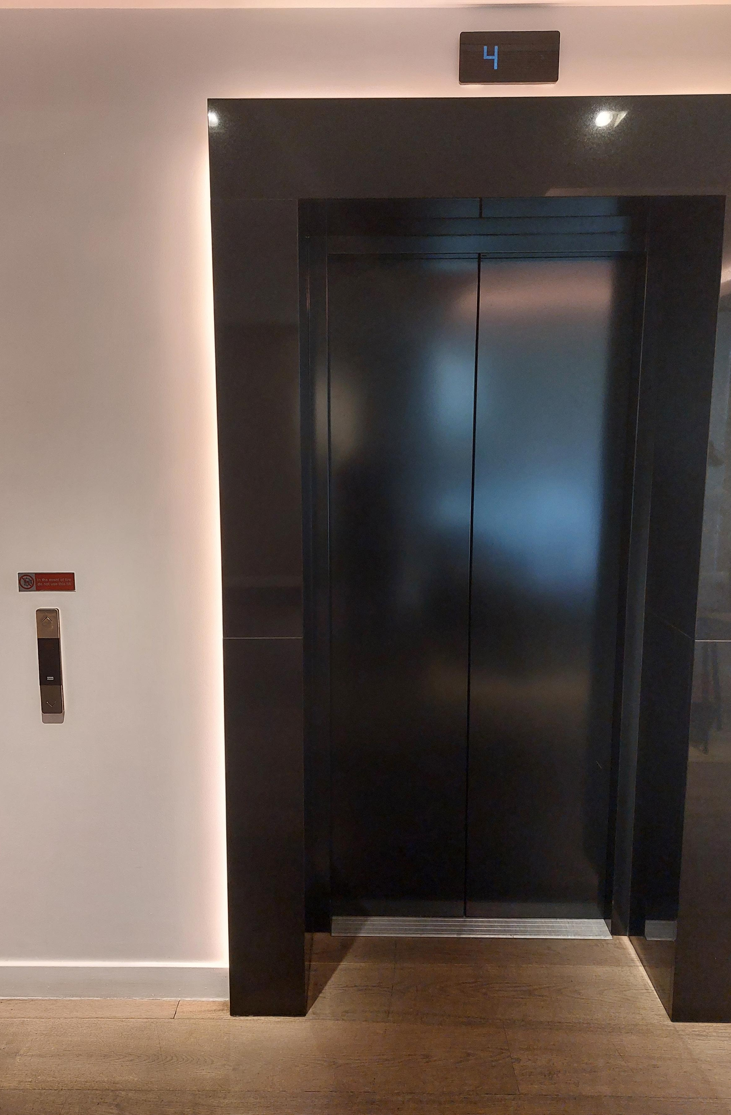
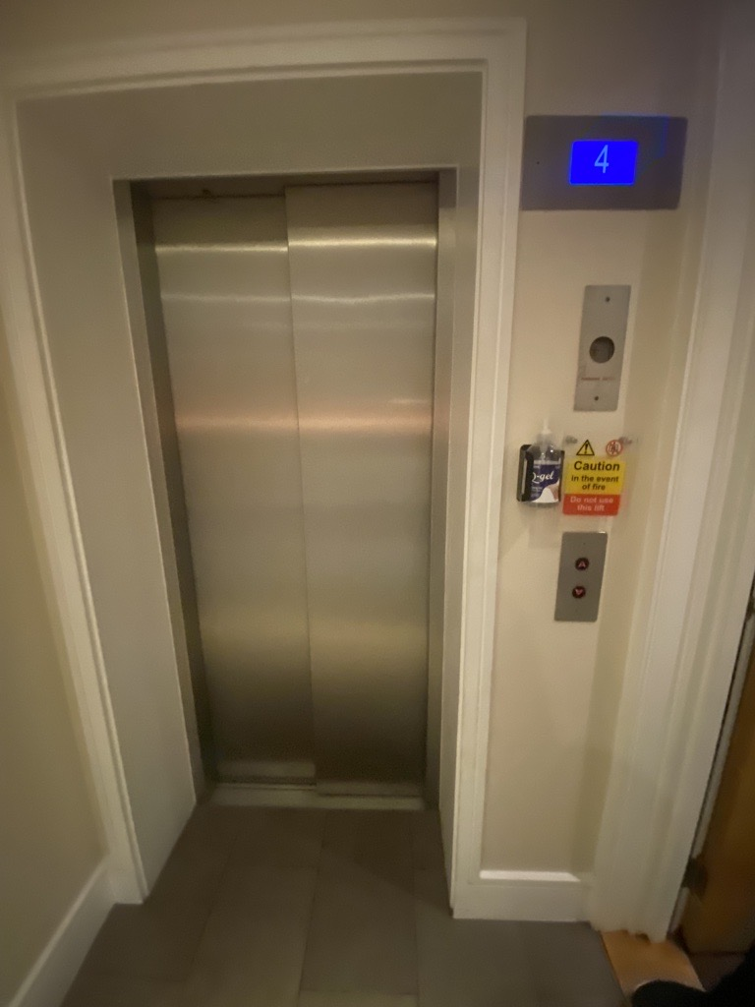
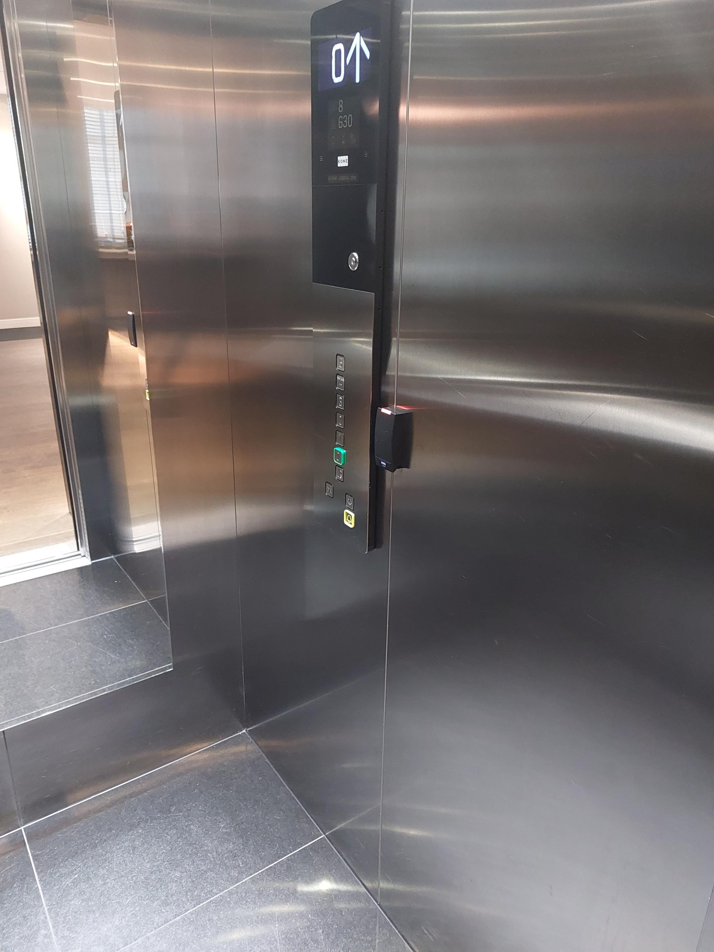
Getting Around the Hotel
Our flooring throughout the hotel varies between laminated wood and carpet, all of which should be free from trip hazards and traversable for wheelchair users. Accessible rooms are on the ground floor in case of emergency.
Our doors each feature wheelchair friendly buttons to guide these to open, placed at an accessible height for wheelchair users. Elevator buttons are tactile for those hard of hearing, while the lift announces as doors open and close. The number of the floor the lift is on is displayed on a digital screen to assist guests hard of hearing. A number of refuge points in case of emergency can be found throughout the hotel, connect guests with accessible concerns to our front of house team.
If you require additional support please speak to a member of our team.

Slide 8
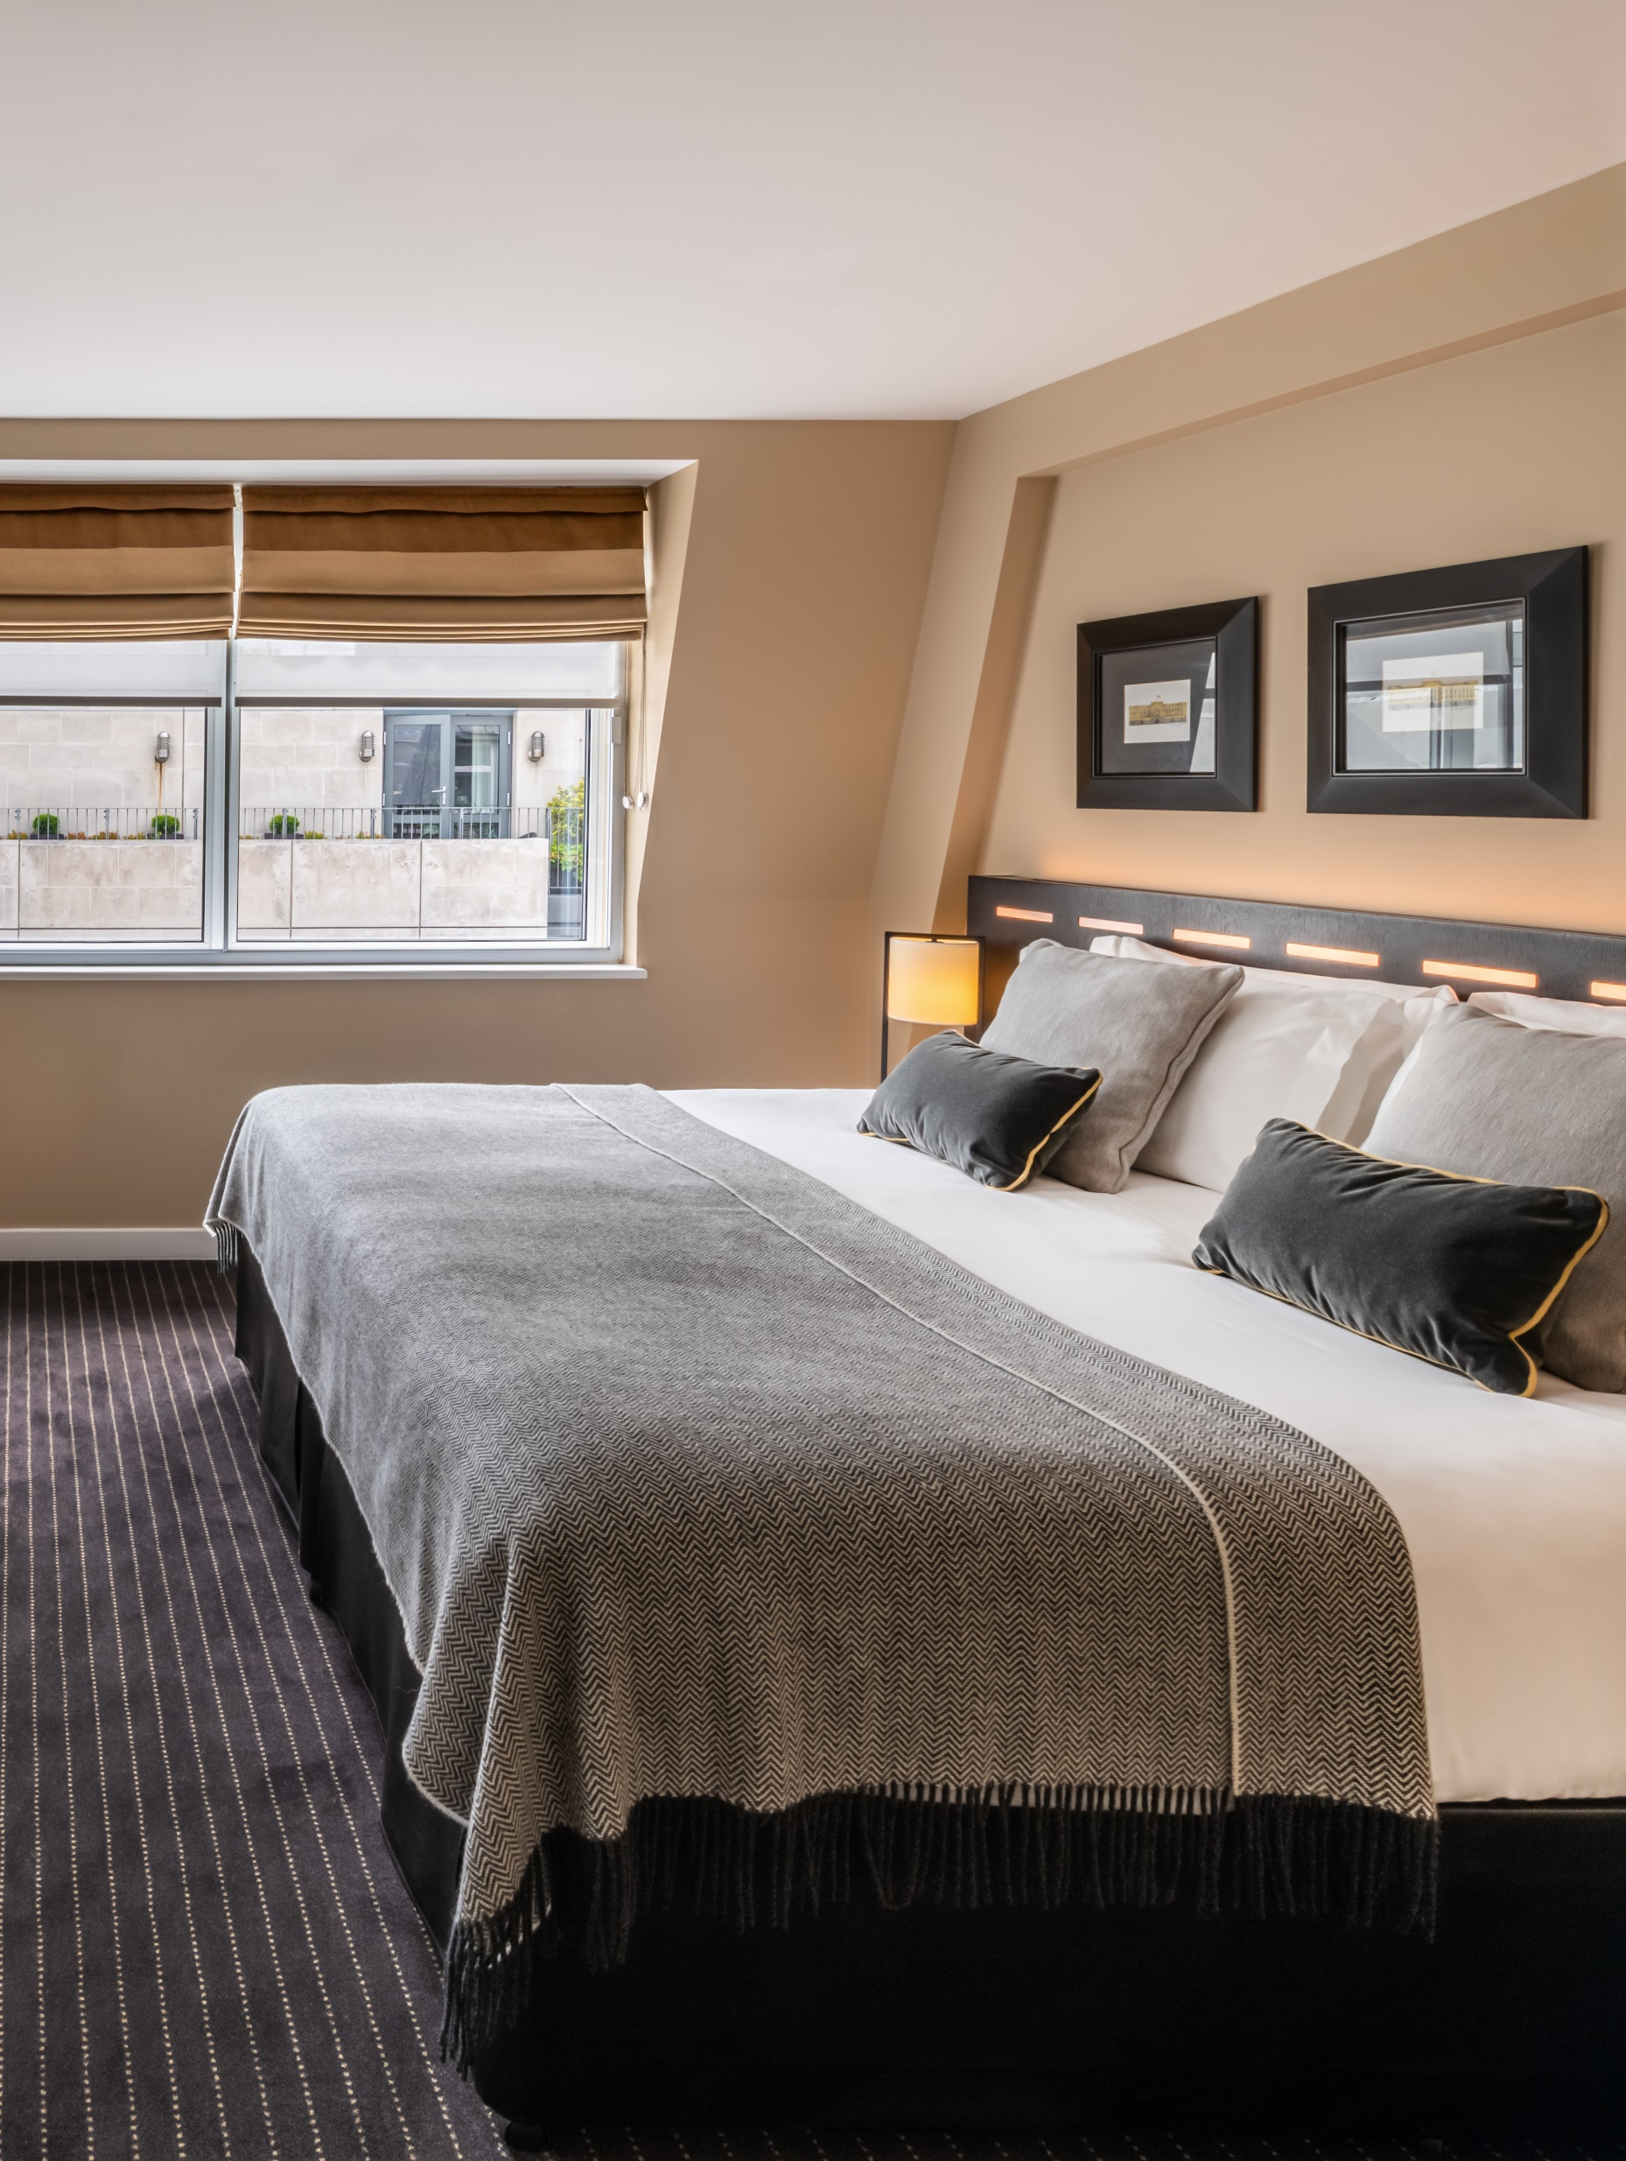
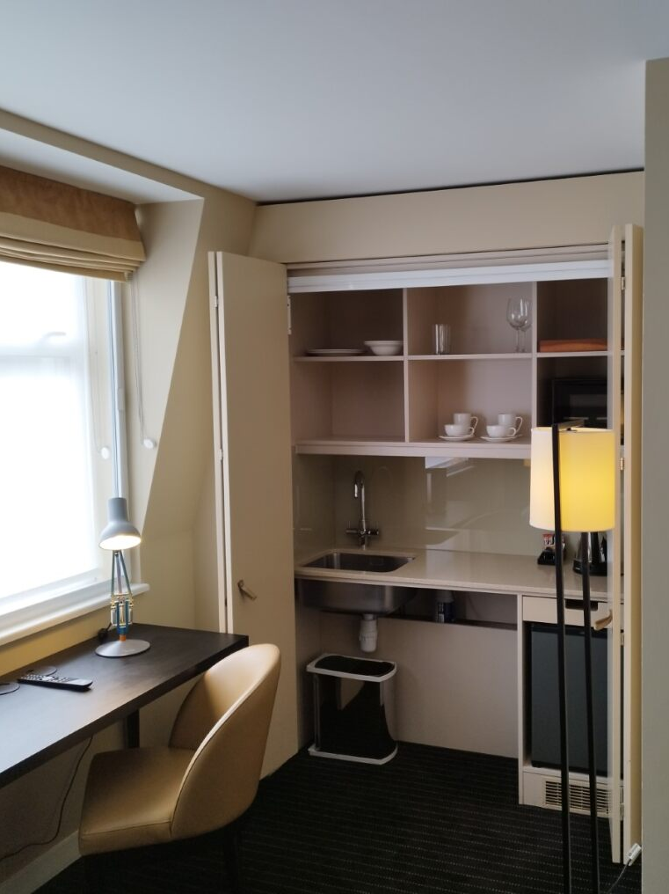
Our Bedrooms
We feature a small selection of accessible rooms featuring additional resources, aids and floor space, designed to suit a wheelchair user or guest with restricted mobility. The following adjustments have been made to make these rooms more accessible…
We have included additional floor space in the bedroom and bathroom.
There are pull chords by the bed, shower and toilet to ensure help is accessible to our guests, these will never be shortened or tied.
An additional peephole is included on the door at a suitable height for wheelchair users.
Our kitchenettes feature space for a wheelchair or chair for those with trouble standing for a long time.
If you require additional space in your room and would like our team to remove some non-essential furniture items, please let us know.

Slide 9
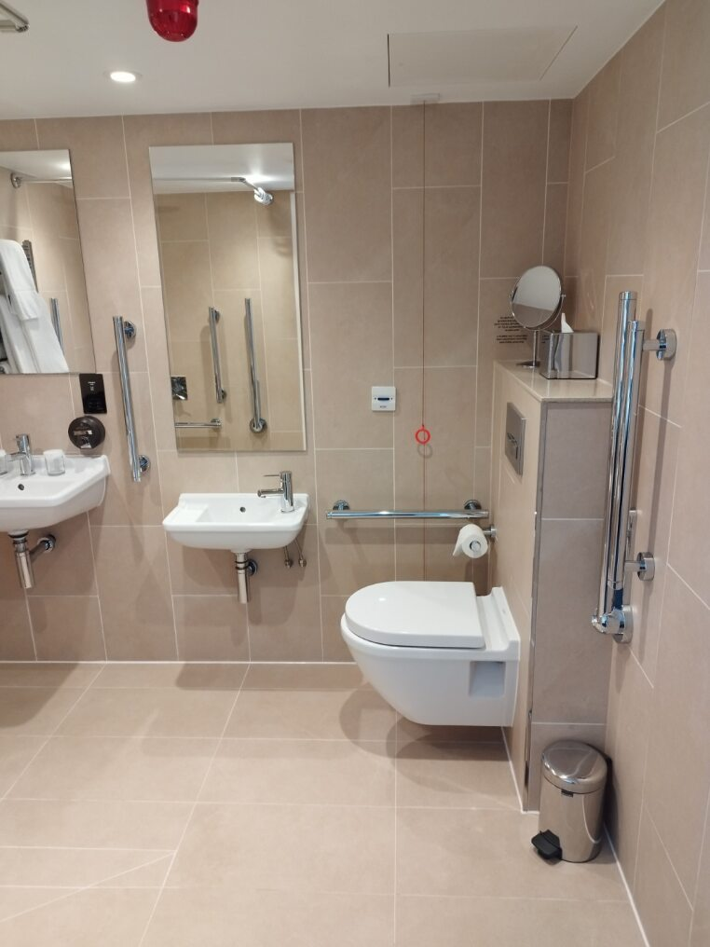
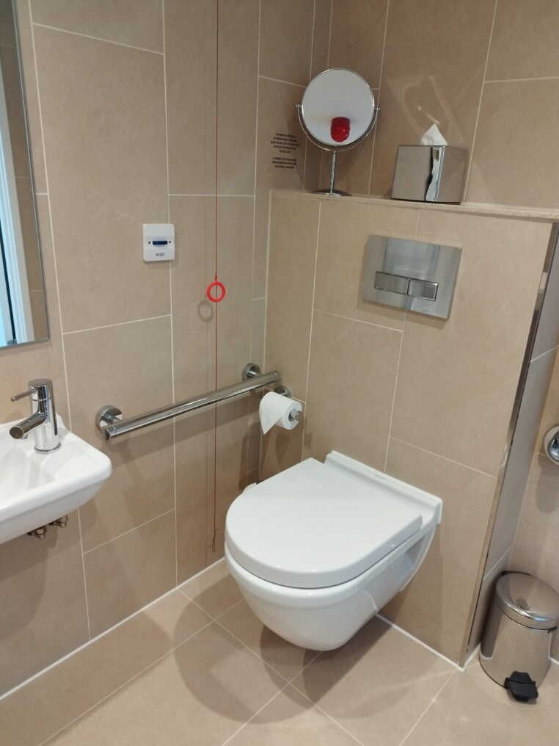
Our Bathrooms
Our accessible bathrooms are designed to accommodate guests with a variety of needs, including ample space for a wheelchair, two sinks at various heights, mobility bars and seats where needed as well as two pull chords (by the toilet and shower), should you require assistance. There is also an additional help button here in case of emergency.
Should you require additional assistance please let us know, our team is on hand to help wherever needed.

Slide 10
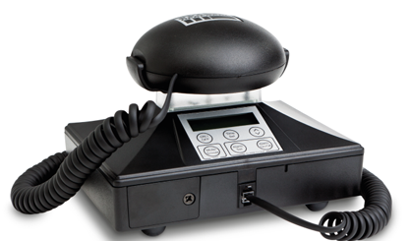
Hearing Impaired Guests
We also offer some adjustments for hearing impaired guests, these include the following…
We can provide a deaf guard to be taken to your room, this will vibrate, light up and flash in the event of an emergency, insuring you can leave the building safely.
Our lifts display floor information on a digital screen, communicating which floor you are currently on.
Our reception desk also features an induction loop for guests.
Accessible rooms include a light over the bathroom door which will then flash if the emergency cord is pulled.
If we can assist you in any other way, please let a member of our team know, they would be more than happy to assist.
Example Deaf Guard

Slide 11
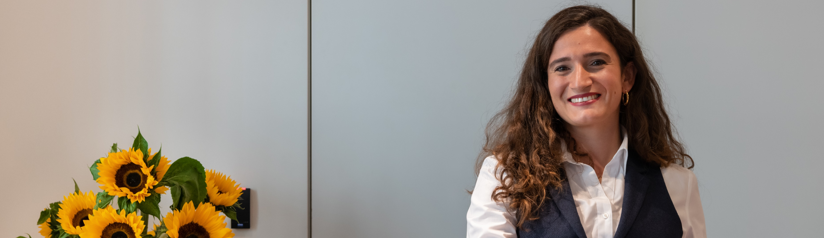
For further assistance
For any additional information of assistance please reach out to us directly at victoria.reception@residenthotels.com or 020 3540 8800 and a member of our team would be more than happy to help!
For assistance within the hotel, dial 0 on our phones to be connected to our front of house team.

